Slide 1
Capital Asset pricing model
Group 3
mAdhurima dutta(m22ma056)
Mansi(m22ma057)
vanshika kumawat(M22ma207)
Nisha shaw(m22ma059)

Slide 2
What is Capital Asset Pricing Model (CAPM)?
CAPM is a financial model used to calculate the expected return on an investment.
It helps investors understand the relationship between risk and expected return.
The model consists of three main components: the risk-free rate, the market risk premium, and the beta.
The risk-free rate represents the theoretical return on an investment with zero risk, typically based on government bond yields.
The market risk premium is the excess return that investors demand for bearing the risk of investing in the market compared to the risk-free asset.

Slide 3
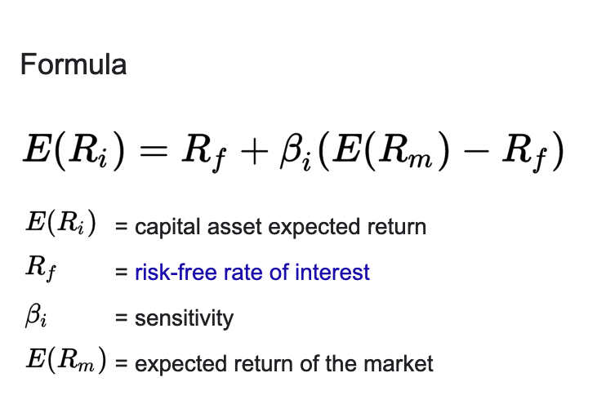
Formula of CAPM:
The formula of CAPM is:

Slide 4
Assets
The Risky assets chosen are
Infosys Pvt Ltd.
Tata Motors
Sun Pharma
HDFC Bank
Reliance Industries
Bharti Airtel
Hindustan Unilever
Tata Steel
Bajaj Finance
NTPC
THE RISK FREE ASSETS IS
INDIA 10 YEAR YIELD

Slide 5
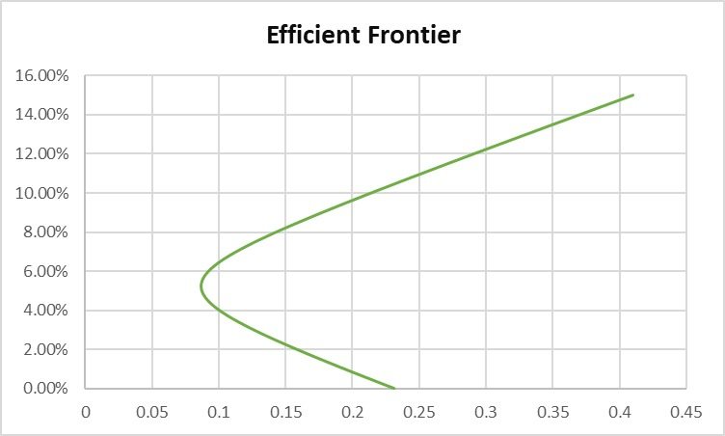
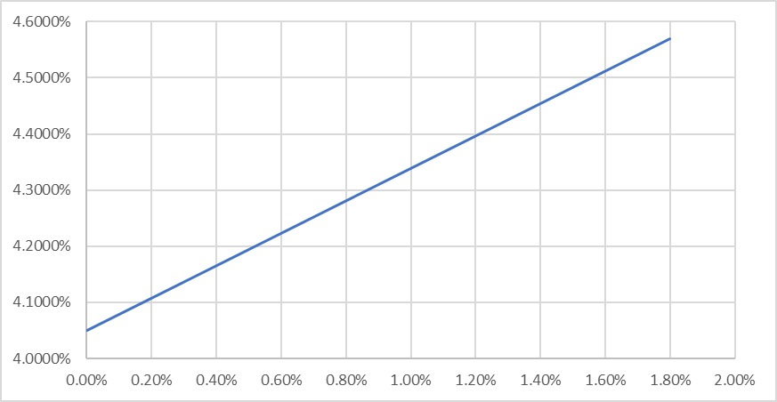
EFFICIENT FRONTIER & CML

Slide 6
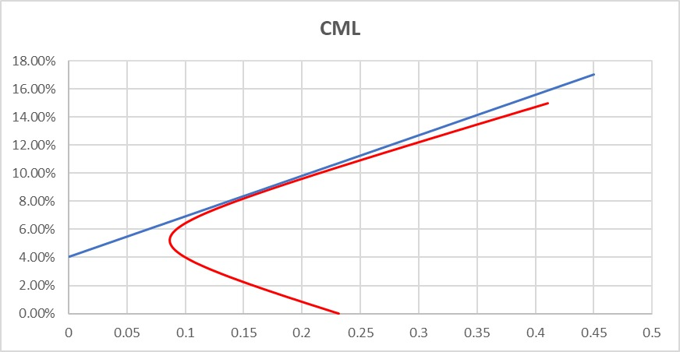
TANGeNCY POINT ON EFFICIENT FRONTIER
Tangency Point (15.90%,8.6451%)

Slide 7
Significance of point of tangency
In the context of the capital asset pricing model (CAPM) and the capital market line (CML), the point of tangency represents the optimal portfolio of risky assets, known as the market portfolio.
Also, the slope of the CML at the point of tangency represents the Sharpe ratio, which measures the excess return per unit of risk.
The point of tangency signifies the Optimal Risk-Return Tradeoff which means the optimal portfolio for investors aiming to maximize return for a given level of risk or minimize risk for a given level of return.

Slide 8

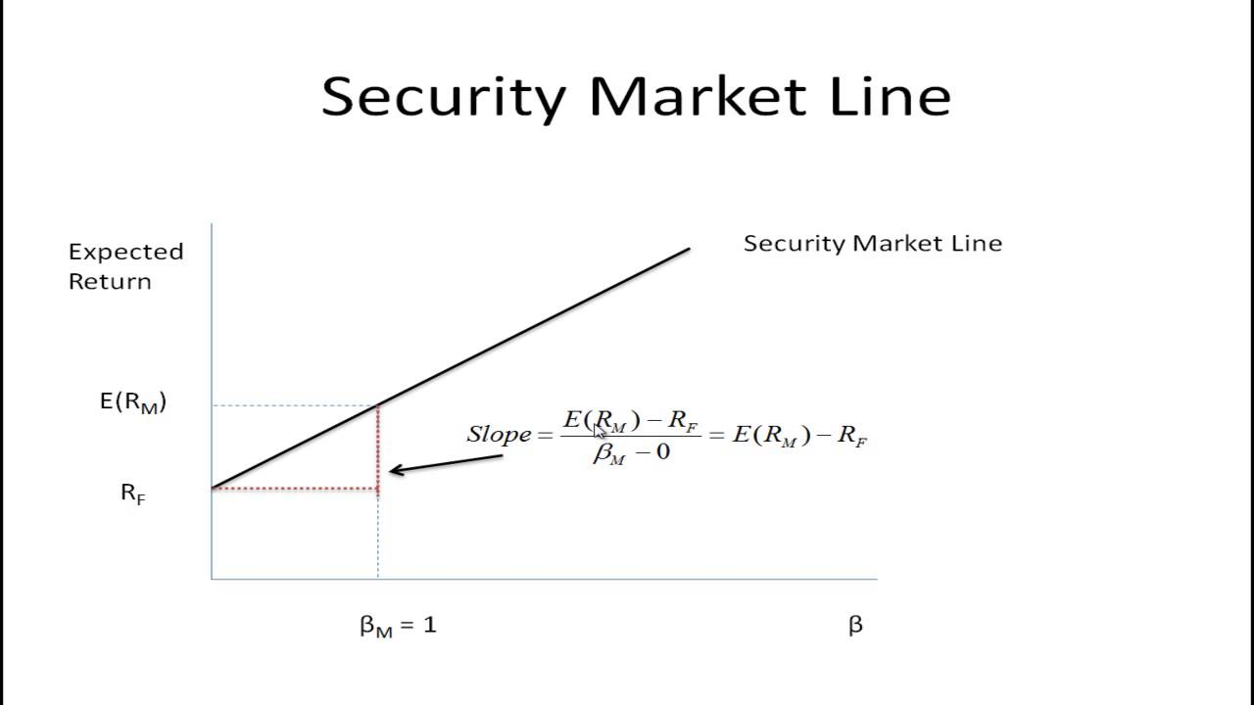
What is Security Market Line (SML)?
The security market line (SML) is a line drawn on a chart that serves as a graphical representation of the capital asset pricing model (CAPM)—which shows different levels of systematic, or market risk, of various marketable securities, plotted against the expected return of the entire market at any given time

Slide 9

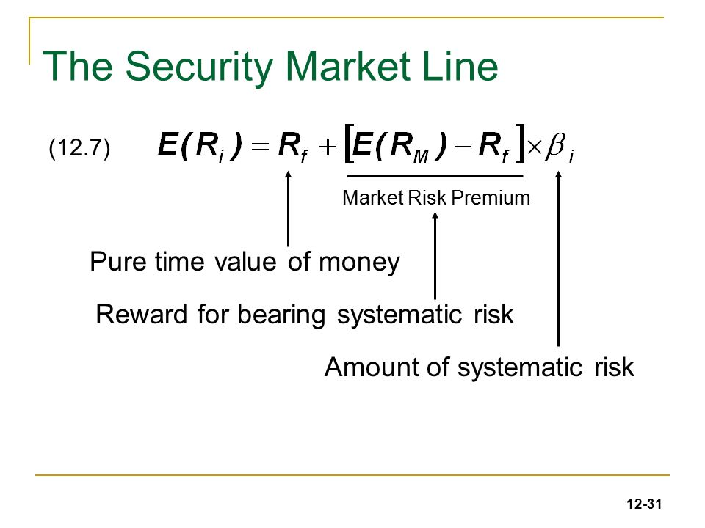
formula of security market line
The formula of SML is given by the equation 12.7 as shown in the diagram.
Market Risk Premium:
The market risk premium represents the additional return investors expect to receive for holding a risky asset compared to a risk-free asset, such as government bonds.

Slide 10
We have chosen three risky asset as security
Infosys Pvt Ltd.
Tata Motors
Sun Pharma
FOR PLOTTING THE SECURITY MARKET LINE
WE HAVE TAKEN THE MARKET INDEX OF NIFTY 50.
Infosys pvt.ltd.

Slide 11
Tata Motors
Sun Pharama

Slide 12
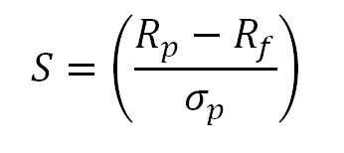
What is sharpe ratio?
The Sharpe ratio compares the return of an investment with its risk. It's a mathematical expression of the insight that excess returns over a period of time may signify more volatility and risk, rather than investing skill.
S=Sharpe Ratio
Rp​=Return of portfolio
Rf​= Risk free return
σp​=standard deviation of the portfolio’s
excess return​.

Slide 13
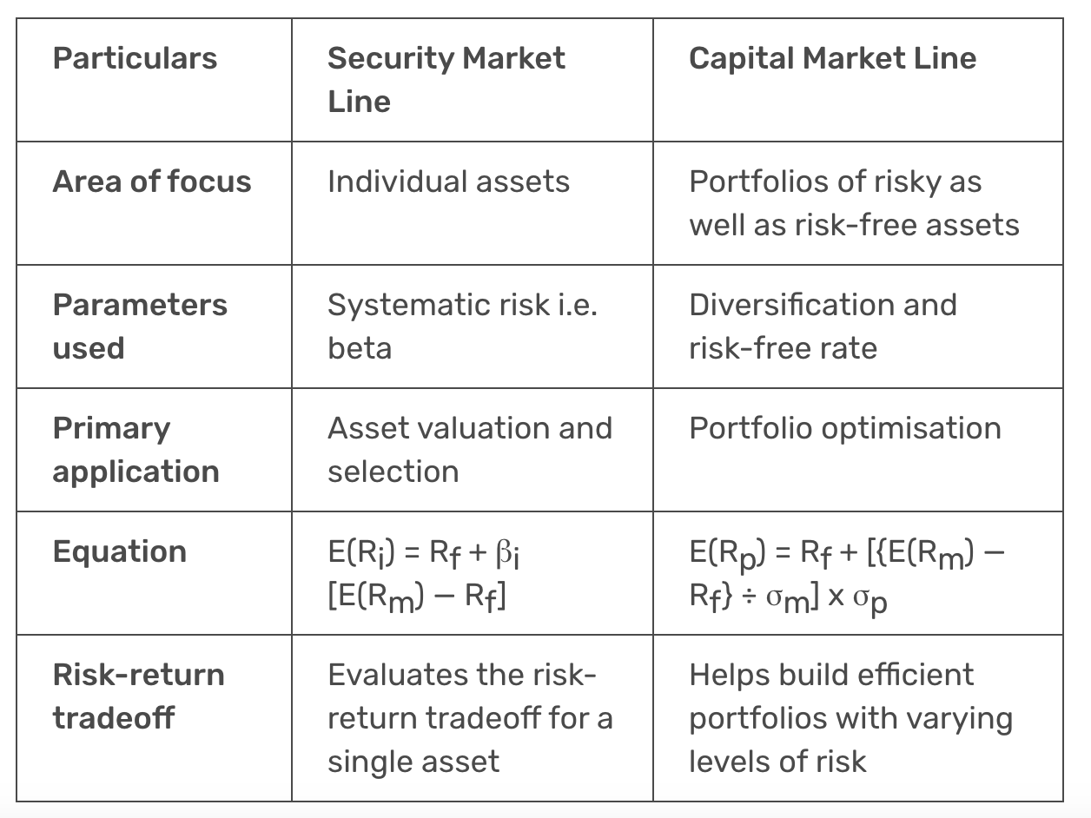
Cml vs. sml

Slide 14
Thank you

